Slide 1
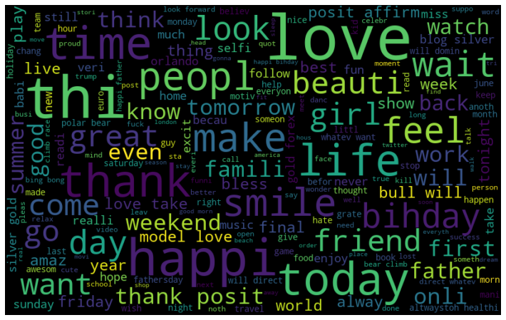
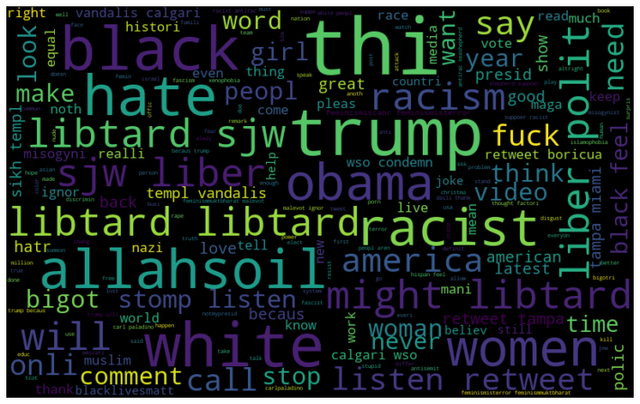
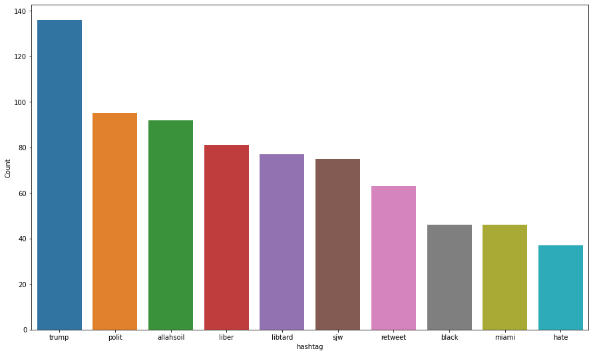
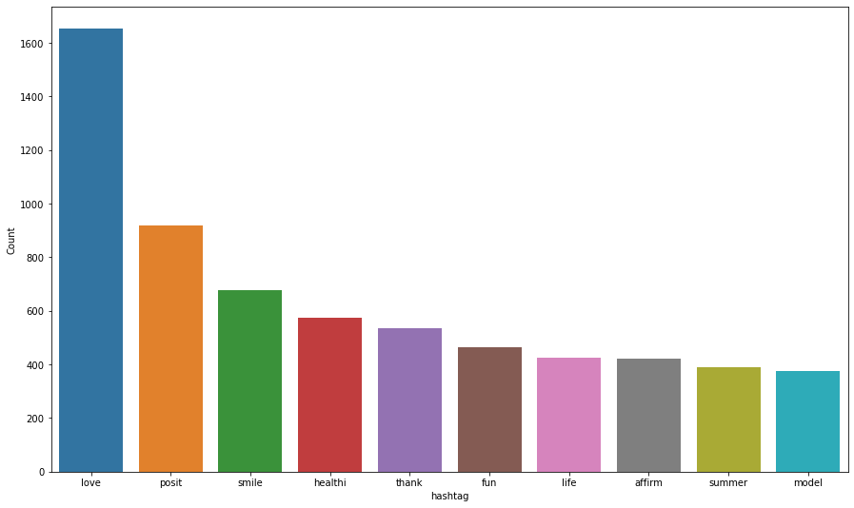
Twitter Sentiment Analysis
The objective of the project is to detect hate speech in tweet
Positive tweet
Negative tweet
Most frequently used word
Top 10 most mention tweet

